Slide 1
Lecture 7: Stochastic optimization EM algorithm Sensitivity analysis

Slide 2
Introduction
Assumed before:
Input variables are continuous
Response is differentiable
We could apply Steepest descent, Newton, BFGS, CG
Now:
Variables can be discrete (scheduling problem, traveling salesman)
Outcome can be discrete, noisy (typical in statistics) or having multiple local minima

Slide 3
Stochastic and combinatorial optimization
Given set of states S, objective to minimize f(s), typically S is large.
Sometimes, exhaustive search is possible (shortest path algorithm)
Often exhaustive search is computationally expensive, sometimes NP-hard (traveling salesman)
Alternative – a solution (sometimes exact) can be obtained by stochastic methods (ex: simulated annealing, genetic algorithms)

Slide 4
Simulated annealing
Idea comes from physics (melted metal is being cooled)
Parameters:
Energy of the metal (decreasing, but not monotonic)
Temperature (decreasing)
How to find minimum energy (global one)?

Slide 5
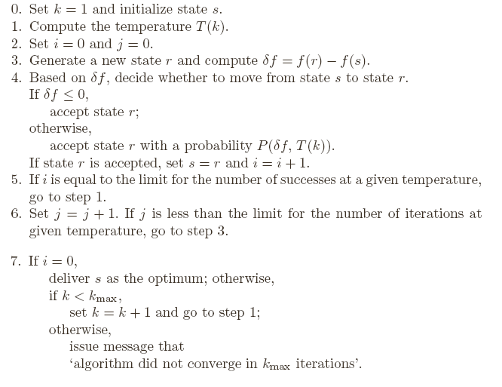
Simulated annealing

Slide 6

Simulated annealing
Comments
How to generate new state?
Continuous inputs: choose new point at some distance r from the current point (r can be a random variable..)
Discrete inputs: same idea or rearrangements
How to choose selection probability
Sometimes chosen as exp(-δf/T)
How to choose temperature function?
continuous or noisy functions, taken constant
Another choice

Slide 7

Simulated annealing
Example: Traveling salesman
Choose initial configuration (A₁…A_{n})
Generate new configuration by 2-rearrangement:
Measure difference in path length δf between new and old configuration
If shorter path found, accept it otherwise accept it with probability P(δf)
Repeat until maximum iteration condition fulfilled

Slide 8
Genetic algorithm
Idea comes from biology (the fittest survives)
Variables=genotypes
Observation=organism, characterized by genetic code
State space= Population of organisms
Objective function=fitness of organism
New points are obtained from old points by crossover and mutation, the population retains only fittest organisms (with better objective function)

Slide 9
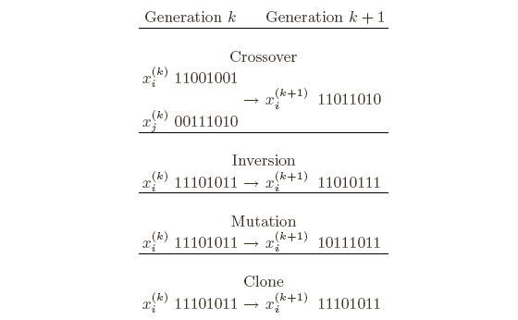
Genetic algorithm
How to code the points
Enumerate each point in S
Code for observation i is presented by binary representation of i
Other encodings are possible
Mutation and recombination rules

Slide 10
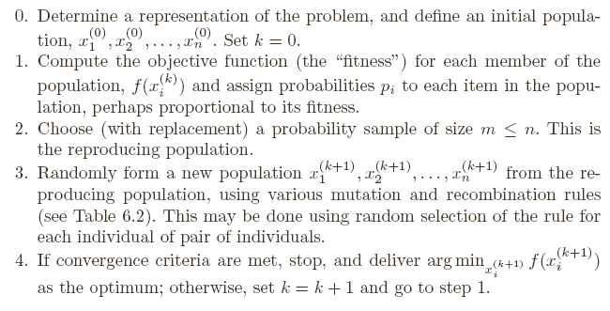
Genetic algorithm

Slide 11
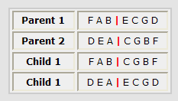
Genetic algorithm
Traveling salesman problem
Encoding and crossover
First idea - encode tours as A₁…A_{n.} Problem:
Instead: Remove FAB from DEACGBF -> DECG. Obtain first child by appending: FABDECG
Second child is obtained by taking prefix from parent 2

Slide 12
Genetic algorithm
Traveling salesman problem
Mutation
If taking small population and using only crossover – the input domain becomes limited, may converge to local solution
Taking large initial population may be computationally heavy
Mutation allows to investigate entire input domain
In traveling salesman, mutation =moving a city in the tour to another position

Slide 13
Genetic algorithm
Traveling salesman problem
Other issues
Reproduction: Among m tours selected at step 2, two best are selected for reproduction, two worst replaced by children
Neighborhood size: large m – some tours are never parents, global solution may not be attained
Mutation probalility should be fixed

Slide 14
EM algorithm
Before: All input variables are known Y
Now: model depends on the variables which are known Y and those that can not be observed Z.
How to find model parameters θ?
Before: Apply maximum likelihood approach
Now: Use EM algorithm

Slide 15
EM algorithm
Let
EM algorithm
Choose starting point θ^{i}, i=0
E-step : Derive Q(θ^{i}, θ)
M-step: Maximize Q(θ^{i}, θ) with respect to θ, θ^{i+1}=optimal θ
Repeat until convergence
Example: Two-component mixture

Slide 16
Objectives of sensitivity analysis
SA is the study of how the variation in the output of a model can be apportioned to different sources of variation.
JRC web-site:
http://sensitivity-analysis.jrc.cec.eu.int/

Slide 17
Examples of questions addressed in SA
Supply-demand models:
How sensitive is the predicted petrol consumption to a major change in price?
Weather forecasting models:
How sensitive are the weather forecasts to the grid size used in the calculations?

Slide 18
Local sensitivity analysis
A local SA is concerned with small changes about some central case of interest and their impact on the outcome of the calculations
Essentially, the objective of a local sensitivity analysis is to find the partial derivatives of the outcome with respect to the inputs at the point in question

Slide 19
Global sensitivity analysis
A global sensitivity analysis is concerned with the whole set of potential inputs and aims to give an overall indication of the way that the outcome varies

Slide 20
Global sensitivity analysis - questions addressed
Which of the uncertain input factors is more important in determining the uncertainty in the output of interest?
If we could eliminate the uncertainty in one of the input factors, which factor should we choose to reduce the most the variance of the output?

Slide 21
Sensitivity with respect to factors
A factor is anything in a model that can be changed prior to its execution
model input (driving force)
model parameter (unknown constant in the model)
one mesh size versus another
one model structure versus another

Slide 22
A simple portfolio model having three independent components
Let
where C_{s}, C_{t}, and C_{u} are the quantities per item and P_{s}, P_{t}, and P_{u} are hedged portfolios.
Assume that P_{s}, P_{t}, and P_{u} are independent with mean zero and different standard deviations (volatilities)

Slide 23
Sensitivity analysis using partial derivatives
Our analysis indicates the largest portfolio to be the most important factor regardless of its volatility

Slide 24
Sensitivity analysis using partial derivatives of fractional change
gives the fractional increase in Y corresponding to a unit fractional increase in P_{x} at a given point in the input space

Slide 25
Sensitivity analysis using partial derivatives normalised with respect to the standard deviation of each factor
When using as a sensitivity measure, the relative importance of P_{s}, P_{t}, and P_{u} depends both on the volatility of these factors and on the weights C_{s}, C_{t}, and C_{u}

Slide 26
A general importance measure applicable to all models with random inputs
After averaging over all possible values of P_{x} we obtain
The ratio
is called importance measure, sensitivity index, or first order effect
The sensitivity index of a factor shows how much the variance of the model output would decrease if you were told the exact value of that factor

